Slide 1
Cash Flow Statement
Presented by:
Akshay Jangid
Harshit Khandelwal
Kartik Shankhavaram(wk)
Malvika Maloo
Nisha Shekhawat
Tirth Shah
13 November, 2019

Slide 2
Financial Statements

Slide 3
Need for Financial Statements
Audited by government agencies etc. to ensure accuracy and for tax purposes
Gives a picture of company’s financial health over a period of time at a point of time
The performance of a company
Notes:
Financial statements are often audited by government agencies, accountants, firms, etc. to ensure accuracy and for tax, financing, or investing purposes.
They give a picture of company’s financial health over a period of time at a point of time.
Investors and financial analysts rely on financial data to analyze the performance of a company and make predictions about its future direction of the company's stock price.
Gives a picture of company’s financial health over a period of time at a point of time.
Investors and financial analysts rely on financial data to analyze

Slide 4
Components
Balance Sheet
Income Statement
Cash Flow Statement
Notes:
Expressed as a “snapshot” or financial picture of the company at a specified point in time
overview of a company's assets, liabilities, and stockholders' equity as a snapshot in time.

Slide 5
Balance Sheet
Assets
Cash and cash equivalents
Accounts receivables
Inventory
Liabilities
Debt including long-term debt
Rent, tax, and utilities
Wages and dividends payable
Equity
Amount of money if all stocks are liquidated
Notes:
Interest earned on cash in the bank
Income from an advertisement display located on the company's property

Slide 6
Balance Sheet
Overview of assets, liabilities, and stockholders' equity as a snapshot in time
Assets = (Liabilities + Equity)

Slide 7
Income Statement
Financial Statement showing company’s profit.
Statement displays:
Revenue
Expenses
Profit
Covers a range of time

Slide 8
Cash Flow Statements

Slide 9
A key principle: Profit ≠ Cash
Profit does not necessarily mean the cash left over after all expenses are paid
Accounting is ‘Accrual’ based i.e. revenue is recorded even if cash is not transferred
Concept of credit involved
Therefore cash flow statements needed to keep track of actual cash

Slide 10
Cash flow statement
Summarizes amount of actual cash received and paid during an accounting period
Provides information related to actual liquidity of the company and capital available to run operations
Does not include future streams of cash, i.e. credit

Slide 11
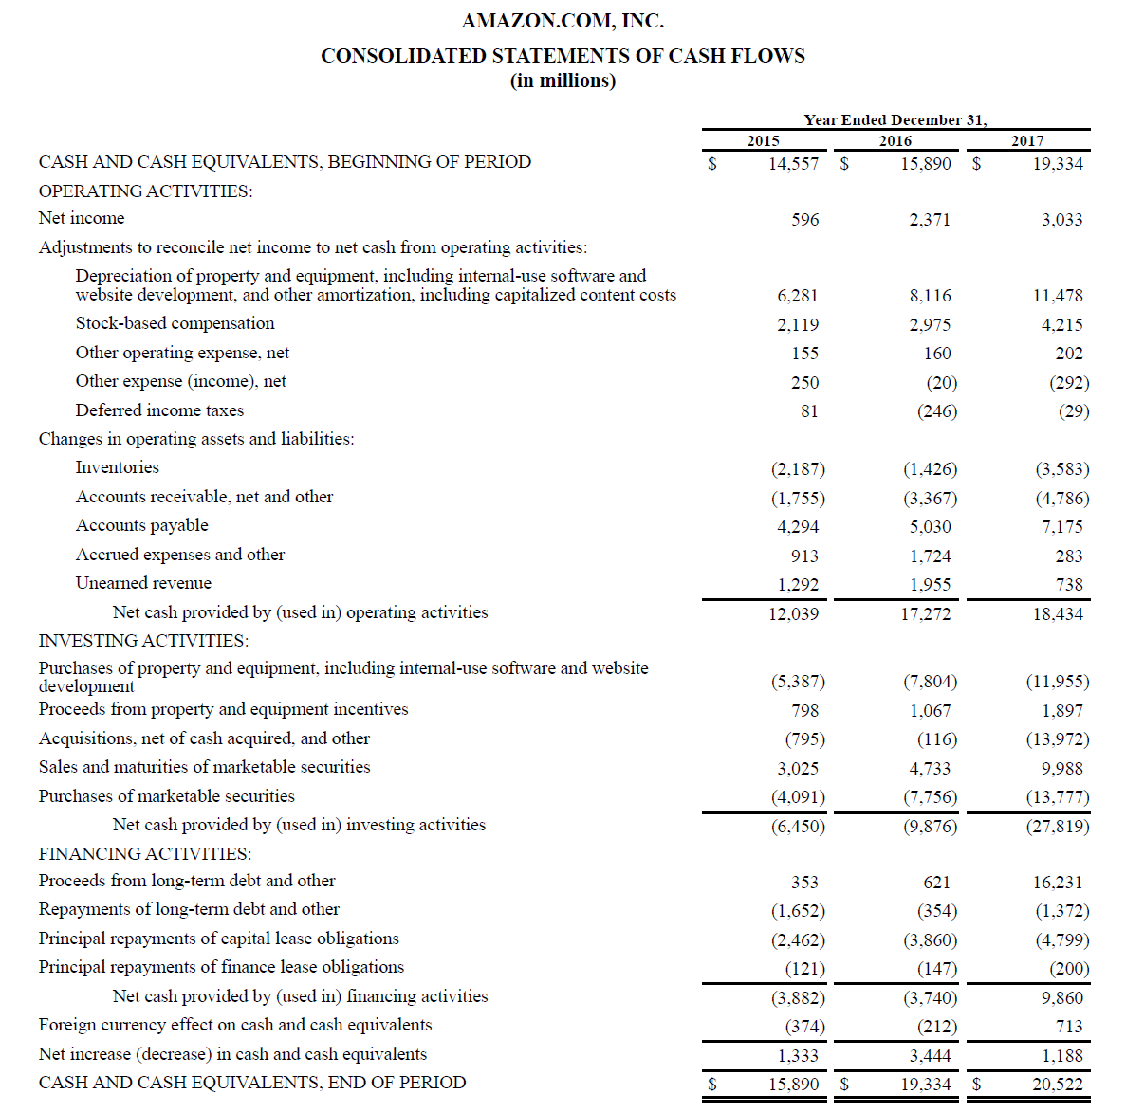

Slide 12
Sections of a Cash Flow Statements

Slide 13
Operating Activities
Amount of money company from ongoing regular business activities
Depicts cash generating abilities of the company
Basically net cash from operating activities are focused upon

Slide 14
Example

Slide 15
Investing Activities
Account of cash used in the purchase of non-current assets.
Investing activity is an important aspect of growth and capital.

Slide 16
Some Investing Activities Are:
Purchase of fixed assets–cash flow negative
Purchase of investments such as stocks or securities–cash flow negative
Lending money–cash flow negative
Sale of fixed assets–cash flow positive
Sale of investment securities–cash flow positive
Collection of loans and insurance proceeds–cash flow positive

Slide 17
Example
Cash flow statement from Apple Inc on June 29,2019.
Negative Cash Flow
Purchases of marketable securities for $21.9 billion
Payments acquiring property, plant, and equipment for $7.7 billion
Positive Cash Flow
Proceeds from maturities of marketable securities for $26.7 billion
Proceeds from the sale of marketable securities for $49.5 billion

Slide 18
Example

Slide 19
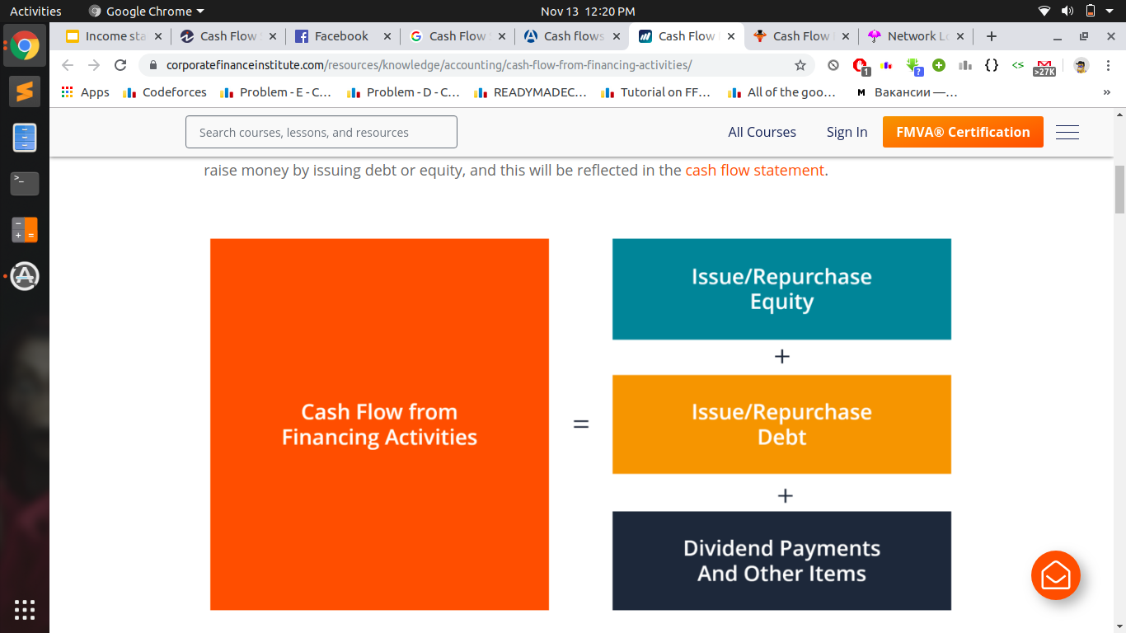
Financing Activities

Slide 20
Financing Activities
Focuses on how a firm raises capital and pays it back to investors through the capital markets.
Include paying cash dividends, adding or changing loans, or issuing and selling more stock.
Measures the flow of cash between a firm and its owners and creditors.

Slide 21
Some financing activities are:
Receiving cash from issuing stock or spending cash to repurchase shares
Receiving cash from issuing debt or paying down debt
Paying cash dividends to shareholders
Receiving cash from issuing hybrid securities, such as convertible debt

Slide 22
Example

Slide 23
Story by Cash Flow
Useful to investors because, under the notion that cash is king, it helps in understanding a company’s overall performance.
It provides clarity of losses from operations or financing investments

Slide 24
More about Cash Flow Analysis
Cash Transactions are included
Complements income statement
Not a test of total financial position
Helps in taking loans

Slide 25

In a nutshell
Profit and loss account of a firm may
show robust topline and bottomline,
it is cash flow statement that reveals liquidity
so necessary for survival and growth of organisation.

Slide 26

DEDICATION:
This presentation is dedicated to

Slide 27



Dedicated to : The Accountants

Slide 28
References:
✔️Sites to Visit
https://www.investopedia.com/terms/f/financial-statements.asp
https://www.investopedia.com/investing/what-is-a-cash-flow-statement/
Cash flow statement example from https://cdn.corporatefinanceinstitute.com/assets/amazon-statement-of-cash-flows.png
https://www.investopedia.com/terms/c/cash-flow-from-operating-activities.asp
❌Sites not to Visit
https://www.quora.com

Slide 29
Thank you!

